Slide 1
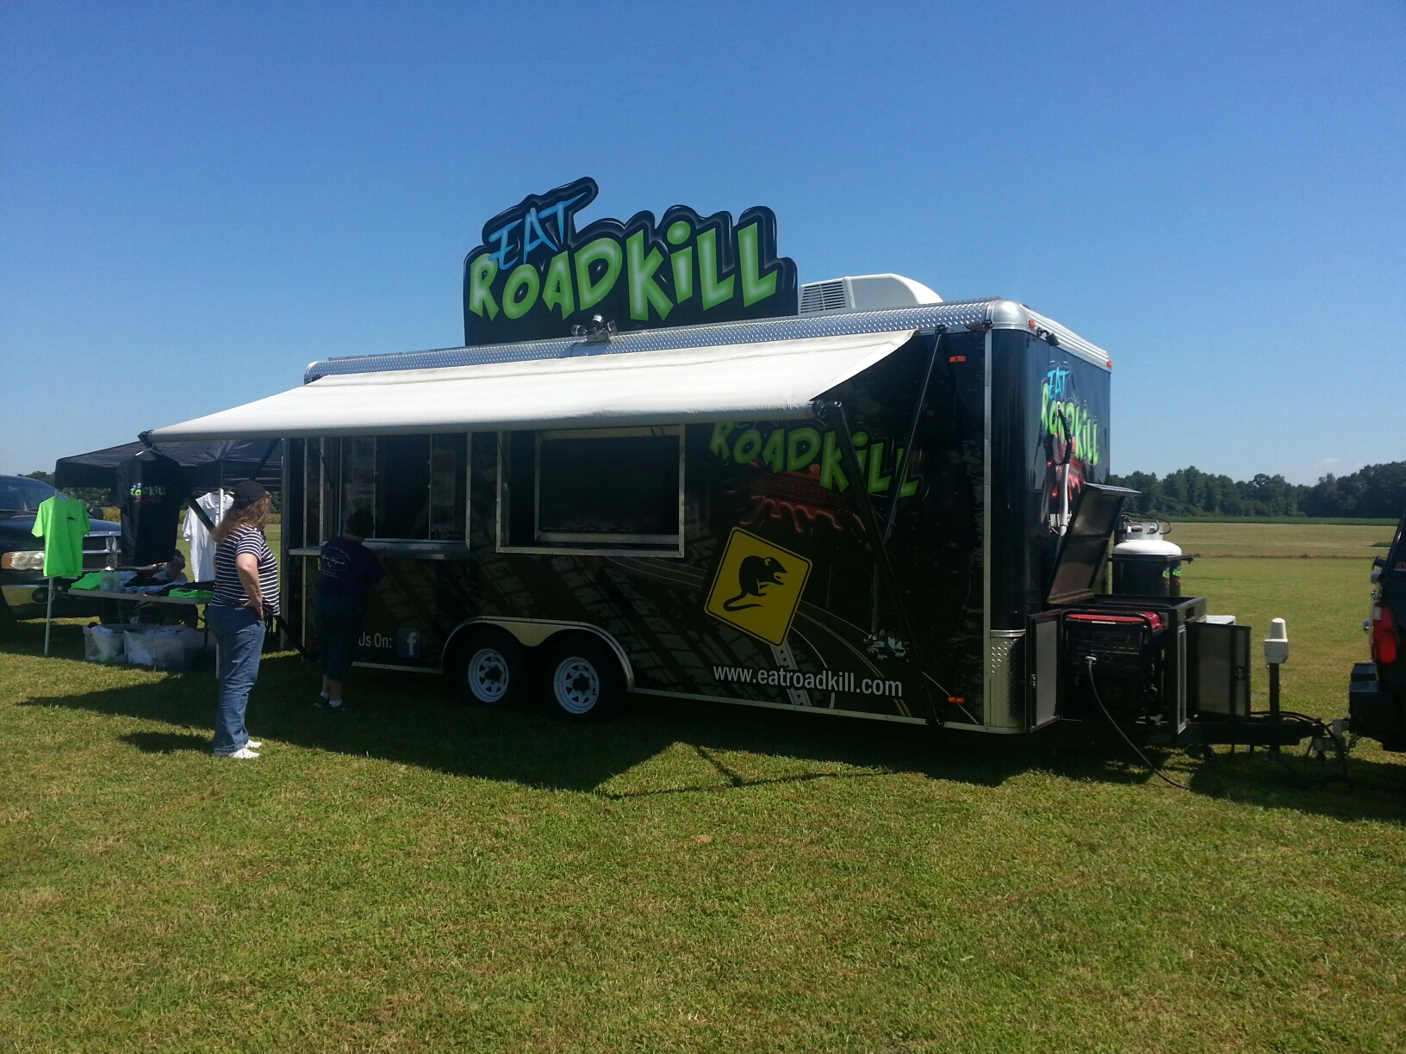
Mobile Food Trucks
Review of the laws and regulations to keep your permit active

Slide 2


Who permits
The county in which the commissary is located
Commissary agreement
How will it be enforced?

Slide 3

§ 130A-249. Inspections; report and grade card.
The Secretary may enter any establishment that is subject to the provisions of G.S. 130A-248 for the purpose of making inspections. The Secretary shall inspect each food service establishment at a frequency established by the Commission. In establishing a schedule for inspections, the Commission shall consider the risks to the population served by the establishment and the type of food or drink served by the establishment. The person responsible for the management or control of an establishment shall permit the Secretary to inspect every part of the establishment and shall render all aid and assistance necessary for the inspection. The Secretary shall leave a copy of the inspection form and a card or cards showing the grade of the establishment with the responsible person. The Secretary shall post the grade card in a conspicuous place as determined by the Secretary where it may be readily observed by the public upon entering the establishment or upon picking up food prepared inside but received and paid for outside the establishment through delivery windows or other delivery devices. If a single establishment has one or more outside delivery service stations and an internal delivery system, that establishment shall have a grade card posted where it may be readily visible upon entering the establishment and one posted where it may be readily visible in each delivery window or delivery device upon picking up the food outside the establishment. The grade card or cards shall not be removed by anyone, except by or upon the instruction of the Secretary. (1941, c. 309, s. 2; 1955, c. 1030, s. 2; 1973, c. 476, s. 128; 1983, c. 891, s. 2; 1987, c. 145; c. 189; 1989, c. 551, s. 2; 1993, c. 262, s. 3; 2005-386, s. 4.1.)

Slide 4

§ 130A‑248. Regulation of food and lodging establishments.
(b) No establishment shall commence or continue operation without a permit or transitional permit issued by the Department. The permit or transitional permit shall be issued to the owner or operator of the establishment and shall not be transferable. If the establishment is leased, the permit or transitional permit shall be issued to the lessee and shall not be transferable. If the location of an establishment changes, a new permit shall be obtained for the establishment. A permit shall be issued only when the establishment satisfies all of the requirements of the rules…..
(b1) A permit shall expire one year after an establishment closes unless the permit is the subject of a contested case pursuant to Article 3 of Chapter 150B of the General Statutes.
(If inspections are not conducted, permit will EXPIRE)

Slide 5
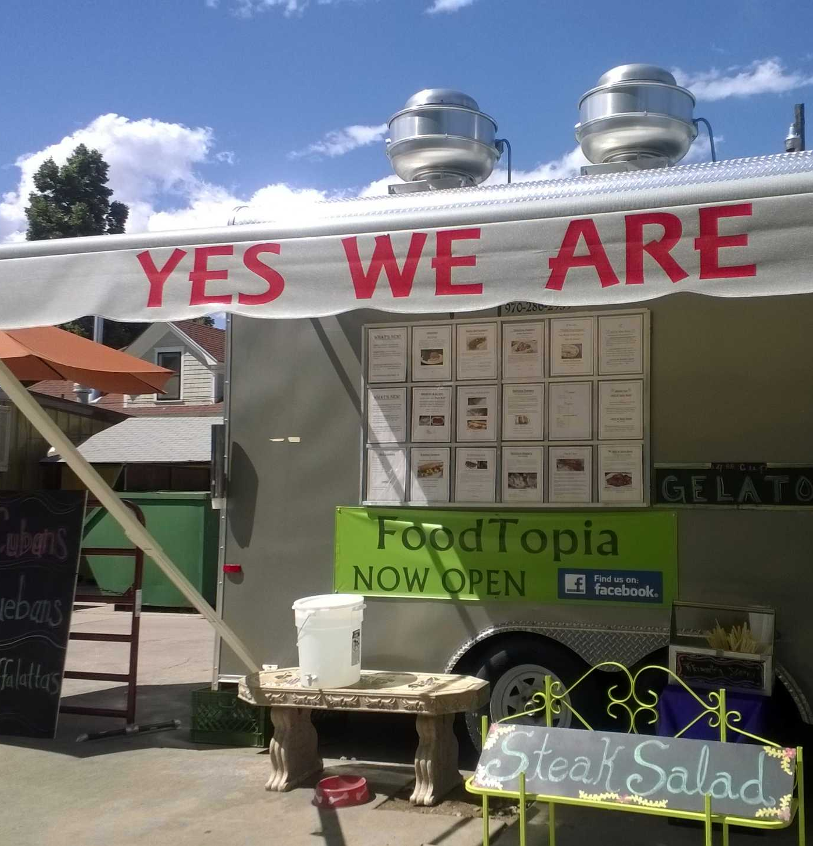
.2670 - GENERAL REQUIREMENTS FOR PUSHCARTS AND MOBILE FOOD UNITS
(1) A permit shall be issued by the regulatory authority that inspects the commissary from which a pushcart or mobile food unit is to operate, if the regulatory authority determines that the pushcart or mobile food unit complies with the rules of this Section. The permit shall be maintained on the pushcart or mobile food unit and made available to the regulatory authority upon request.
(2) The regulatory authority that issues the permit shall be provided by the permit holder a list of counties and locations where each pushcart or mobile food unit will operate.
(3) Prior to initiating food service operations in a particular county, the pushcart or mobile food unit permit holder shall provide the regulatory authority in each county in which food service operations are proposed a list of locations where they will operate. Such lists must be kept current (See Blue QR code).
This Photo by Unknown Author is licensed under CC BY

Slide 6
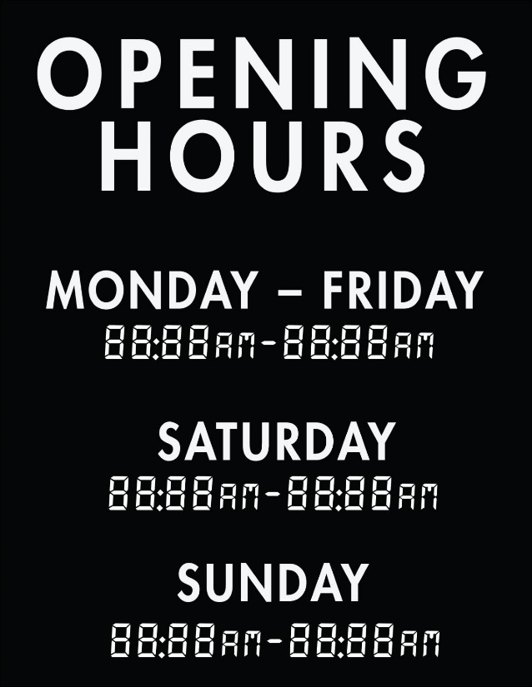
What does that look like?
Blue Sheet QR Codes are provided to use for MONTHLY schedules. This is required (on or before) 1st day of each Month.
This form must be filled out for every unit, each month (even if not in operation).
This form will have:
Dates you are working
Hours you are working
Address where you are working
What time you report to commissary
Must also notify other Counties you will be operating in (if operating in another county).
This form can be updated as frequently as needed.
If a scheduled day is canceled, please notify the County that you are operating in.

Slide 7
Monthly Reporting Sheet
https://docs.google.com/forms/d/e/1FAIpQLScTasrInwtzWFU_E6N_haT96utgwHQ-qU2lBohSy-Cc8JH2tQ/viewform

Slide 8
Commissary Log Sheets
When reporting to the commissary:
Must fill out the log sheet located at the commissary. CANNOT fill out for multiple days.
These log sheets help you provide documentation, you are reporting to the commissary on a daily basis.
Must do all food operations at the commissary. CANNOT use your home or other location to do food prep, food storage or servicing of MFU.

Slide 9
Inspections
Will be random, unannounced based on your submitted schedule.
NO “Scheduled” inspections just to get inspection.
Inspections are RISK BASED and must occur when Mobile Food Unit is in FULL operation selling food to the public.
Will NOT occur at the commissary.
Will NOT occur when you have limited menu.
Will NOT occur when you only operate very limited days in Johnston County.

Slide 10

Failure to adhere to these conditions…..

Slide 11

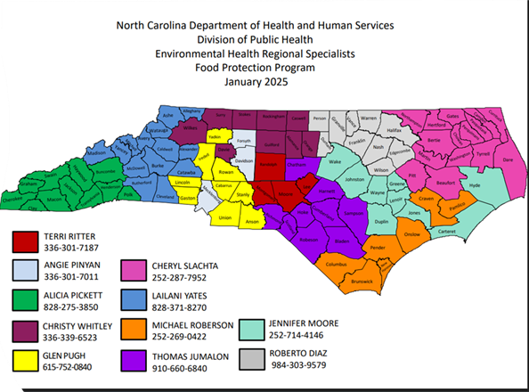
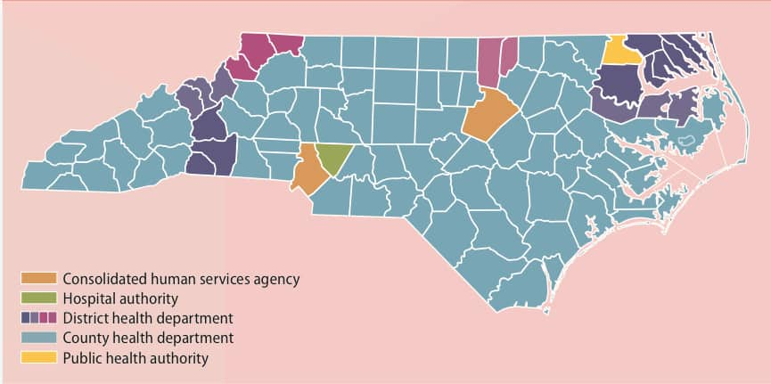
Tools to help you:
https://www.dph.ncdhhs.gov/media/1606/open
County Points of Contact
NCDHHS Food Protection Regional Specialist Point of Contact

Slide 12
Questions?
Effective: September 1st, 2025

